Slide 1

PLANT DISEASE FERTILIZER RECOMMENDATION SYSTEM
PRESENTED BY
CSE: B003
SALLA SAKETH(18UK1A05A7)
THALLADA SAITEJA(18UK1A05B2)
PALAKURTHI RAHUL(18UK1A05A1)
GAYAPU SINDHU RAJ(18UK1A05D2)

Slide 2

CONTENTS: CONTENTS:
INTRODUCTION
OBJECTIVE
FLOW CHART
PROJECT FLOW
DATA COLLECTION
IMAGE PROCESSING
OUTPUT
MODEL BUILDING FOR FRUIT DISEASE PREDICTION
MODEL BUILDING FOR VEGETABLE DISEASE PREDICTION

Slide 3
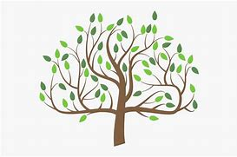
INTRODUCTION:
Agriculture is the most important sector in today’s life. Most of the plants are affected by a wide variety of bacterial and fungal diseases. Diseases on plants placed a major constraint on the production and major threat to food security. Hence, early and accurate identification of plant diseases are essential to ensure high quantity and best quality. In recent years, the number of diseases on plants and degree of harm caused has increased due to the variation in pathogen varieties, changes in cultivation methods and inadequate plant protection techniques.
An automated system is introduced to identify different diseases on plants by checking the symptoms shown on the leaves of the plant. Deep learning techniques are used to identify the diseases and suggest the precautions that can be taken for those diseases.

Slide 4

OBJECTIVE:
By the end of this project you’ll understand:
Preprocess the images.
Applying CNN algorithm on the dataset.
How deep neural networks detect the disease.
You will be able to know how to find the accuracy of the model.
You will be able to Build web applications using the Flask framework.
Work with AWS DynamoDB, Lambda and API Gateway.

Slide 5
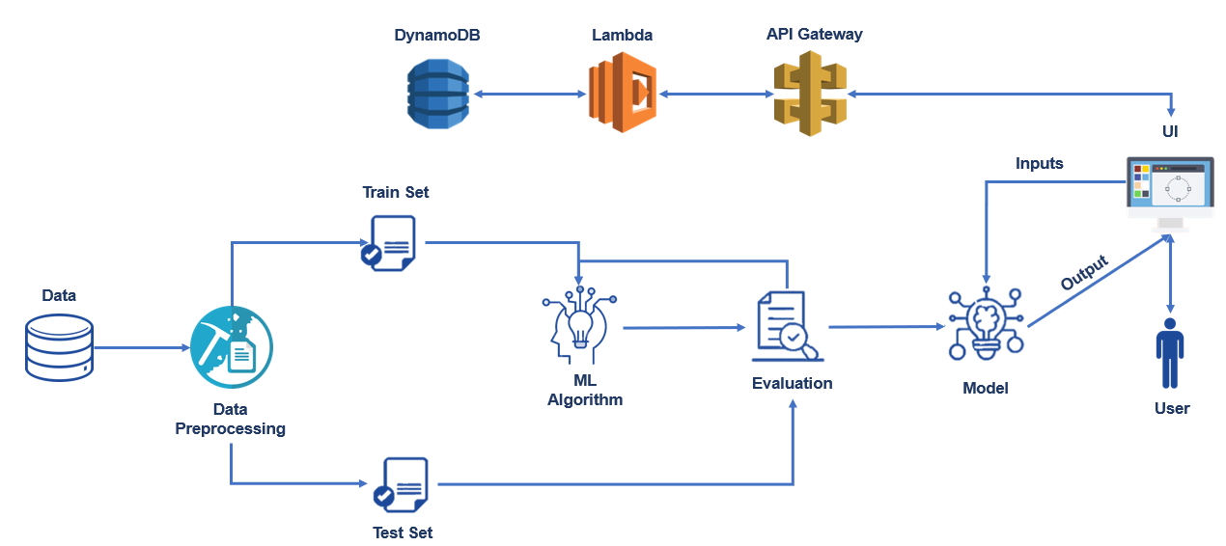
FLOW CHART:

Slide 6
PROJECT FLOW:
A web Application is built where :
Farmers interacts with portal build
Farmers get registered and logins to the portal
Interacts with the User Interface to upload images of diseased leaf
Our model built analyses the Disease and suggests the farmer with fertilizers which are to be used.

Slide 7

To accomplish the above task you must complete below activities and tasks :
Download the dataset.
Classify the dataset into train and test sets.
Add the neural network layers.
Load the trained images and fit the model.
Test the model.
Save the model and its dependencies.
Create DB on AWS cloud to store and retrieve the user data using Lambda and API Gateway.
Build a Web application using flask that integrates with the model built.

Slide 8
DATA COLLECTION:
Create Train and Test folders with each folder having subfolders with leaf images of different plant diseases. You can collect datasets from different open sources like kaggle.com, data.gov, UCI machine learning repository, etc.
The folder contains the provided in the project structure section has the link from where you can download datasets which can be used for training. Two datasets will be used as, we will be creating two models one to detect vegetables leaf diseases like tomato, potato and pepper plants and the second model would be for fruits diseases like corn, peach and apple.

Slide 9
IMAGE PROCESSING:
Now that we have all the data collected, let us use this data to train the model . before training the model you have to preprocess the images and then feed them on to the model for training. we make use of Keras Image Data Generator class for image preprocessing.
Image Pre-processing includes the following main tasks
Import Image Data Generator Library.
Configure Image Data Generator Class.
Applying Image Data Generator functionality to the trainset and test set.

Slide 10
MODEL BUILDING FOR FRUIT DISEASE PREDICTION:
We are ready with the augmented and pre-processed image data, Lets begin our model building, this activity includes the following steps.
Import the model building Libraries
Initializing the model
Adding CNN Layers
Adding Hidden Layer
Adding Output Layer
Configure the Learning Process
Training and testing the model
Saving the model

Slide 11
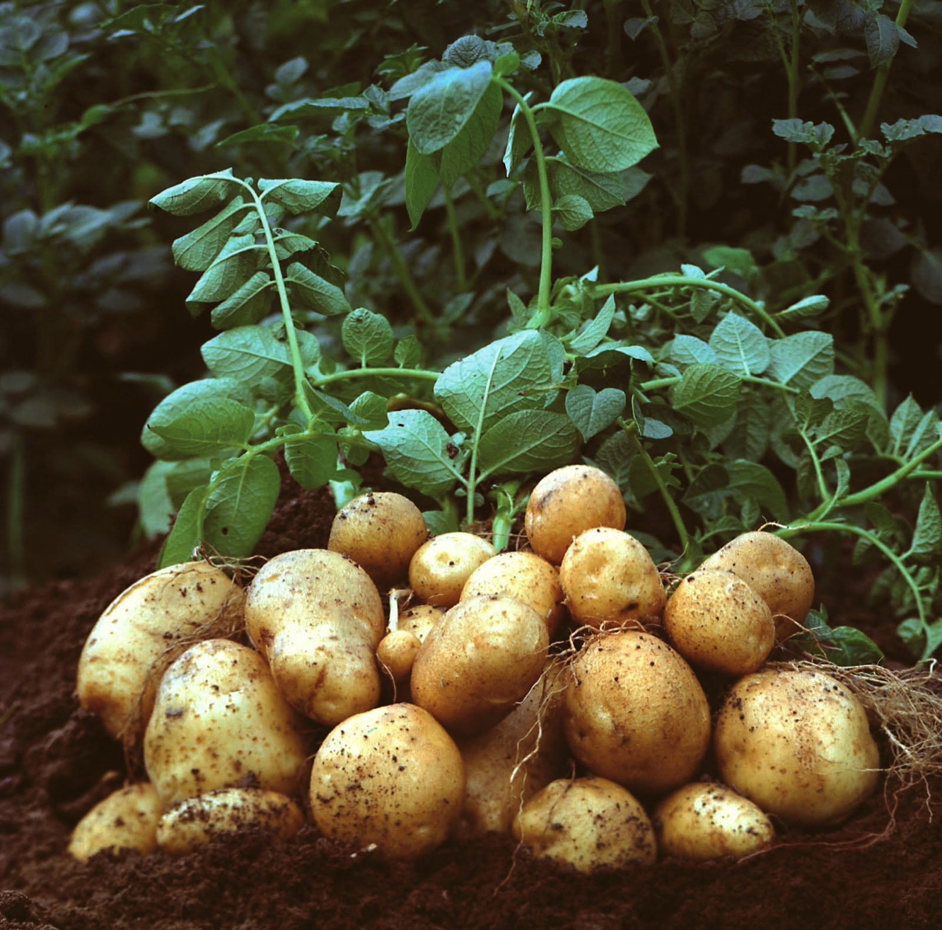
MODEL BUILDING FOR VEGETABLE DISEASE PREDICTION:
Create an other jupyter notebook file in the project folder and name it as vegetable training. The same steps followed for fruit disease prediction model are to be followed to train the tomato, potato and pepper diseases.

Slide 12
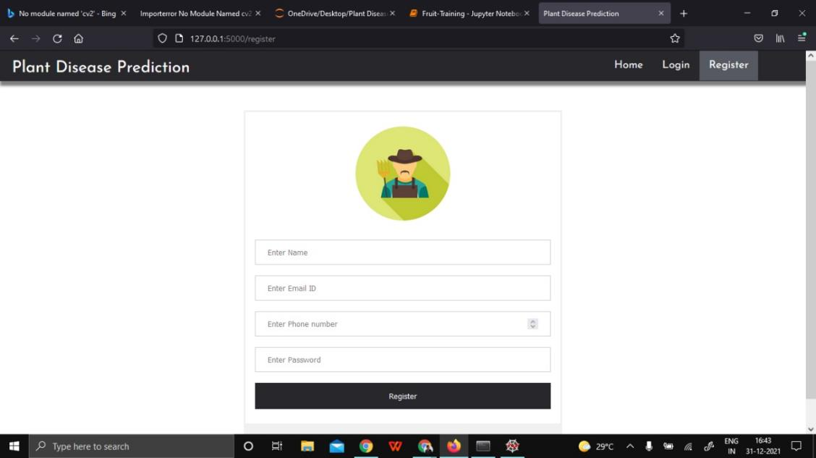
OUTPUTS:
This is the registration page the user needs to provide the necessary details for getting login into
the page where you predict the plant disease.

Slide 13
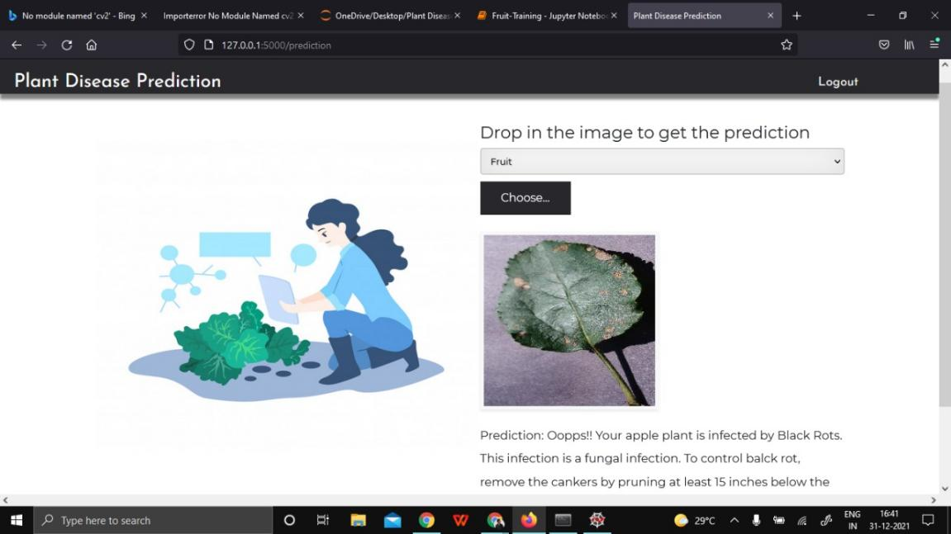
Here we are selecting fruit plant i.e, apple plant image as input it will predict the plant condition
And recommends a fertilizer to cure that plant disease.

Slide 14
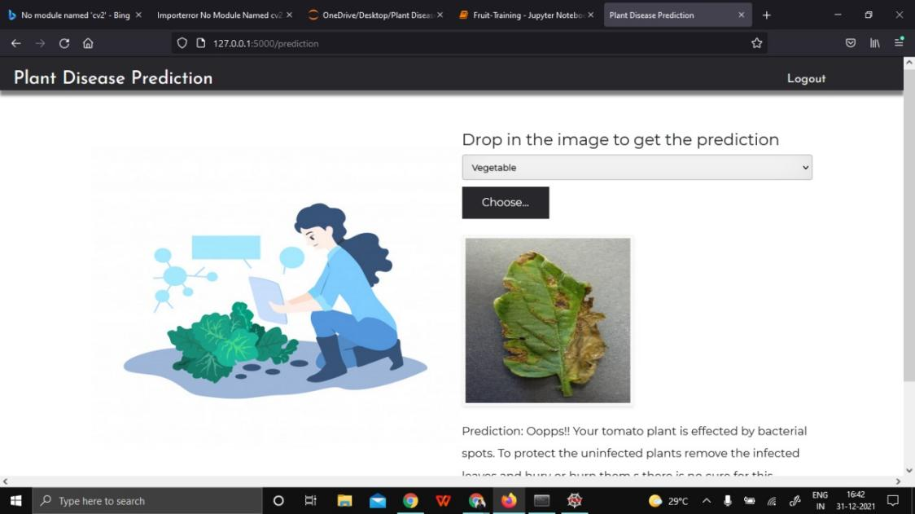
Here we are selecting vegetable plant i.e, tamato plant image as input it will predict the plant condition
And recommends a fertilizer to cure that plant disease.

Slide 15
THANK YOU…….

